Slide 1
IDTE – Innovation Drive and Technology Expo
January, 7th - 2019
Notes:
Brad/Joyce
Remind people to submit questions to everybody in the webex chat to make sure we can see them. We will take answer all questions at the end of the presentation.

Slide 2
Background
IDTE – Innovation Drive and Technology Expo is a five-day yearly in-house event showcasing advanced and research technologies to senior management. This event helps Ford Motor Company in pursuing the highly ranked technologies for production.
The registration is for 3 groups:
Suppliers: Outside companies/universities working with Ford teams on advanced and research projects.
Presenters: Ford employees presenting the technologies to the evaluators.
Evaluators: Ford upper management evaluating shown technologies.
There is a need to develop a tool for the registrations using Ford Corporate approved technologies.
Notes:
Brad

Slide 3
Current Status
A tool has been partially developed by UofM graduates using Open Source technologies like PHP and MySQL.
Risks:
Currently, PHP and MySQL technologies are not IT approved standard technologies.
IT Budget for Server Infrastructure and people (PDO) needed to be identified.
Technologies might not receive approvals since Microsoft SQL and Oracle are the standard database platforms that are being licenses and supported by Ford.
Initial assessment of the software quality needs to be revisited/improved.
Notes:
Joyce, Khalil if any questions on time zone launches

Slide 4
Recommendations
The Ford Corporate IT Digital Worker and PD team recommends the solution to be developed using the Microsoft Sharepoint platform that is license by Ford, hosted and supported by IT.
Advantages:
SharePoint is a corporate tool from Microsoft that has been used with in Ford for more than 6 years.
Digital Worker team has expertise and can provide training and help resolve issues. The maintenance of the SharePoint sites are done centrally by the Digital Worker team.
There is no cost involved as SharePoint is a corporate tool.
Tool is easy to learn and self help is available. No Coding required.
PD team can help customize the solution for the first phase to kick start the development.
Potential Risks:
The PD team is working with the DW team to find out if SharePoint can be provided for external to Ford to address security aspects of the solution (Confidentiality).
Notes:
Joyce, Khalil if any questions on time zone launches

Slide 5
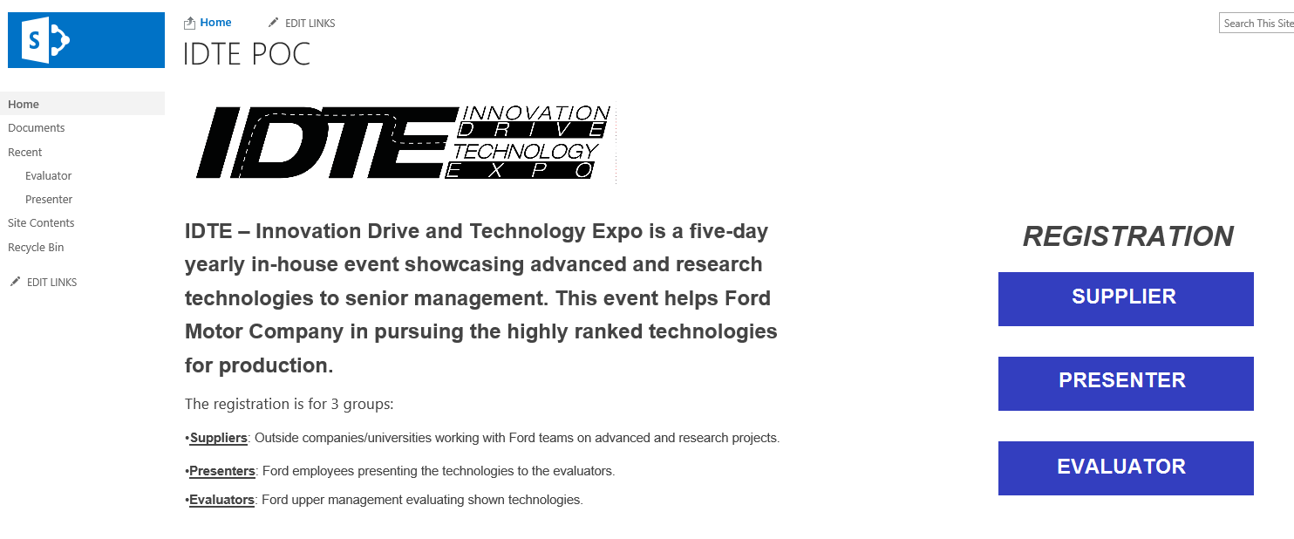
Screen Shot of the SharePoint POC
PD IT team developed a prototype the “ITDE Registration tool” based on the requirements from the PowerPoint deck shared with IT teams.
RIC team can learn and take the ownership of the site for final utilization.
Digital Worker and PD IT will assist with further training.
https://it1.spt.ford.com/sites/PDAM/IDTE/SitePages/Home.aspx

Slide 6
Demo, Q&A

